Slide 1
Life in the CS Department
PhD Student Orientation
September 22, 2022
Debby Inenaga, CS Director of Finance & Operations
Omar Ochoa – Gates Building Manager
Hector Gamez – Gates Facilities Specialist

Slide 2
Life in the CS Department
Your Life Line
Finance – purchases, travel, reimbursements
Working in the Gates Building

Slide 3
Your Life Line
= Your Faculty’s Administrator!
Listing found at:
https://cs.stanford.edu/internal/admin-info/assignments-era-and-admin-staff
When all else fails, go to:
Jay Subramanian & PhD student services team:
jayanthi@stanford.edu or phdstudentservices@cs.stanford.edu
Debby Inenaga, Director of Finance & Operations: dinenaga@stanford.edu

Slide 4
Finance
**Ask your faculty’s administrator for advice before you proceed!!
Stanford Purchases –
“How does this benefit Stanford?”
Necessary and Reasonable
Travel expense guidance –
All travel must be booked through Stanford booking channels!
https://fingate.stanford.edu/business-travel-expenses/student-travel#anchor-10831
University Pcard vs Expense Reimbursement
Finance policies: https://fingate.stanford.edu/

Slide 5
The Gates Building
Gates Building Access:
Building access is through the Lenel card reader system: use your Stanford ID card for after hours (after 7 pm, before 7 am) & weekends.
For Lenel card access problems: email fixit@cs.Stanford.edu
Office Keys:
Work through your faculty’s administrator to find out your desk assignment for the quarter
Go to the Shipping/Receiving office in Gates B18 (basement) to get your office key. Keys require a $20 deposit and photo ID.
Shipping/Receiving office hrs: M-F 8 am – 4 pm. Closed noon – 1 pm
Shipping/Receiving Packages:
The shipping address for Gates building is:
353 Jane Stanford Way, Stanford, CA 94305
**please make sure to have Your name, Gates Building & office number on the addressee label
**write to fixit@cs.Stanford.edu if you are expecting a pkg

Slide 6
The Gates Building – cont’d
Conference/Meeting rooms:
Gates has meeting rooms of various sizes throughout the building. The smaller (4 persons or less) rooms are first come first serve unless noted.
For larger conference rooms, the reservation system is 25Live
Work through your faculty admin to make a reservation or send email to dinenaga@Stanford.edu to get access to the 25Live reservation system
Rooms should be cleared and cleaned after your meeting
** Meeting rooms should only be used for Stanford business **
Two Gates spaces are controlled by the department:
Brown Institute Room (174): browninstitutereservations@cs.stanford.edu
AT&T Patio/Gates Backyard: fixit@cs.Stanford.edu
Notes:
Pontificate a bit ☺

Slide 7
The Gates Building – cont’d
Building Maintenance:
Bikes need to remain outside the building and should not obstruct walkways, doorways or ramps
Bathrooms are located on every floor with gender neutral bathrooms on the first and fifth floors
Room temperature controlled by university facilities with the room occupant able to set temperature two degrees up or down for the room. Opening a window in the room will shut off the AC for the room. Space heaters are not allowed
Printer/Copiers are located on every floor. Ask your faculty admin for the copy code
Recycling,Compost and Trash bins are located in Gates kitchens and outside large mtg rooms. Cardboard can be placed near the elevators
Notes:
Pontificate a bit ☺

Slide 8
The Gates Building – cont’d
Health and Safety:
First aid kits are located in every kitchen.
Automatic External Defibrillators (AED) Locations: 1st floor lobby next to front door and 3rd floor lobby outside of the elevators.
ADA Emergency Call buttons: installed outside the elevator lobbies on the basement level, 2nd through 5th floors and are for emergency use only. In the event of a fire alarm, the elevator automatically gets recalled to the first floor. If a disabled person is unable to reach the 1st floor, then the button will call 911 to provide a location to emergency responders of the person who is unable to exit the building.
Notes:
Pontificate a bit ☺

Slide 9
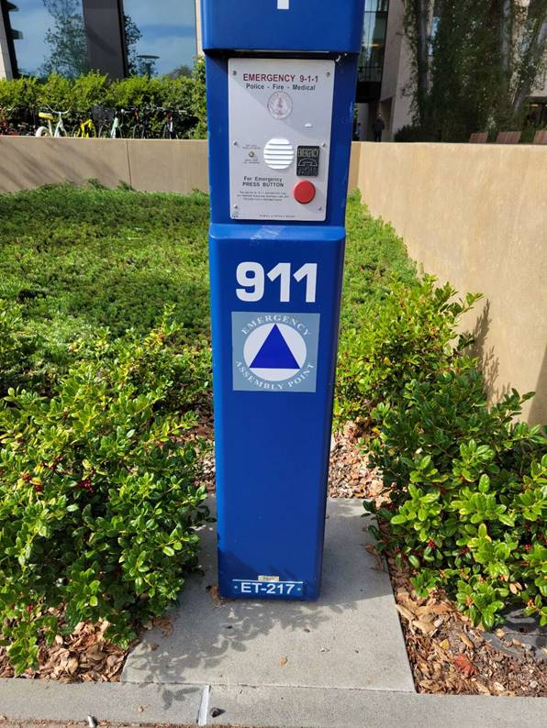
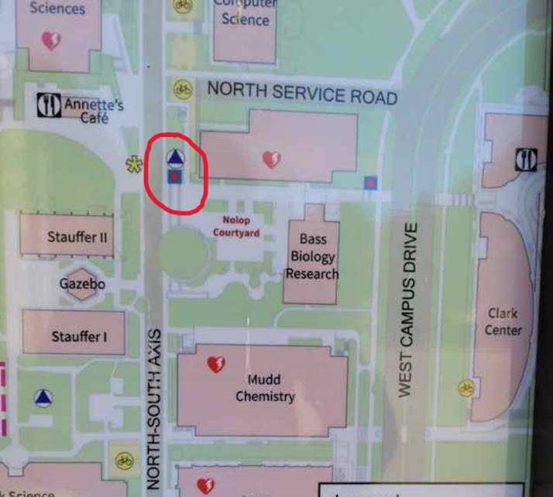
The Gates Building – cont’d
Emergency Assembly Point: located next to the Bass Biology Building across from Annette’s Café “The Blend”
Notes:
Pontificate a bit ☺

Slide 10
Welcome again and we’re glad you’re here!
THE END

