Slide 1
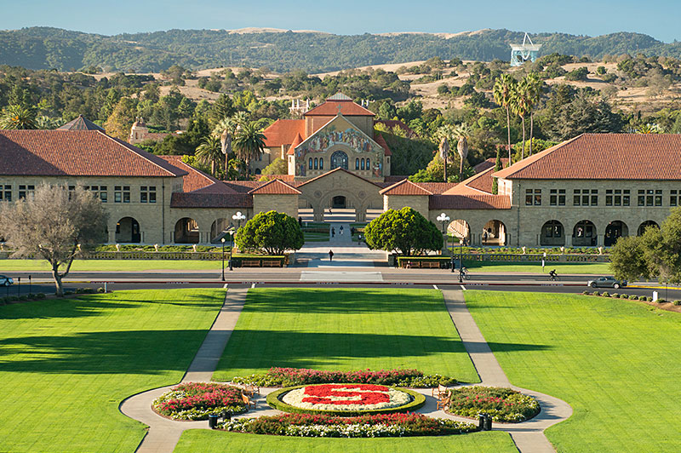
PhD New Student Orientation

Slide 2
Reminders:
Pick up keys for Gates building at Room B18 on Friday, September 23, 9am to noon and 1pm to 3pm.
For more questions on PhD program, please email phdstudentservices@cs.stanford.edu

Slide 3
Overview of Academic Requirements for the PhD
Year
One: • CS 300
• Rotation program, choosing a permanent research advisor
Two: • Completing Breadth requirements
• 3 units of coursework from at least 4 different faculty members
• Filing for Candidacy
Three: • Quals
• Teaching requirement
Four: • Reading committee Form and thesis proposal
Five, Six: • Complete 135 units
• Orals
• Dissertation

Slide 4
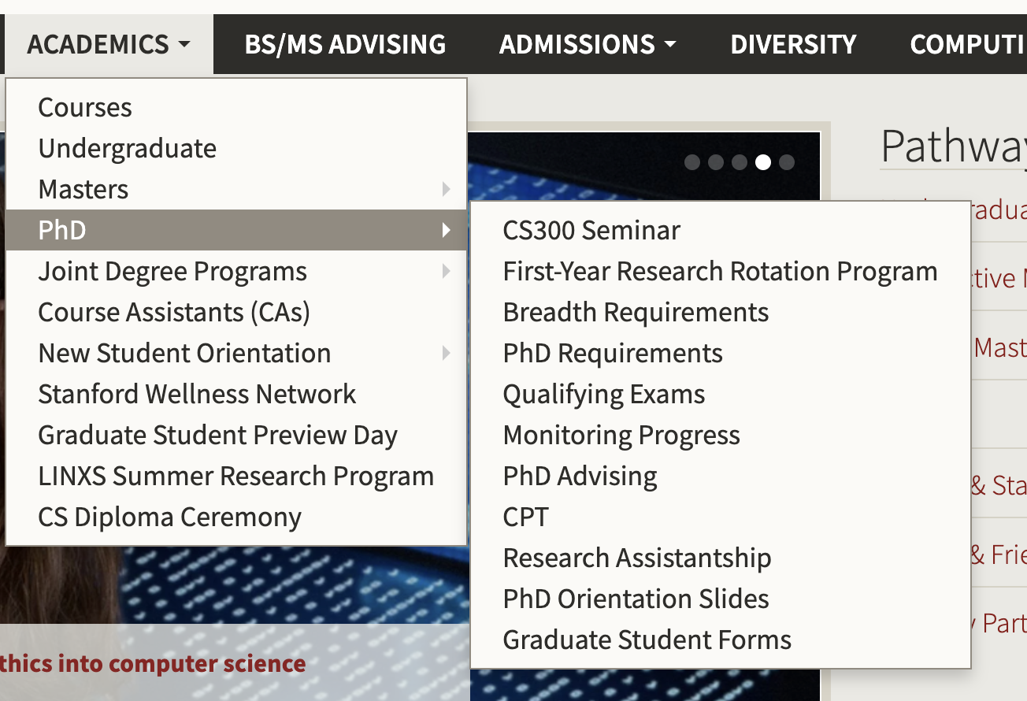
PhD Academic Requirements

Slide 5
Department requirements
Minimum enrollment is 8 units. Total units should not exceed 10 units in each quarter.
First quarter – 1 unit of CS 300 and at least 3 units of CS 499 with faculty (or research equivalent of CS 499 for students rotating with faculty outside of CS department).
CS faculty advisor for alignment. If principal advisor is not CS, then you need a CS faculty co-advisor.
University requirement of GPA 3.0 to graduate.

Slide 6
Financial Support
Everyone gets funding support.
Sources of support
- Research Assistantship
- Fellowship – external/internal
- Course Assistantship
You will be getting details regarding your funding.

Slide 7
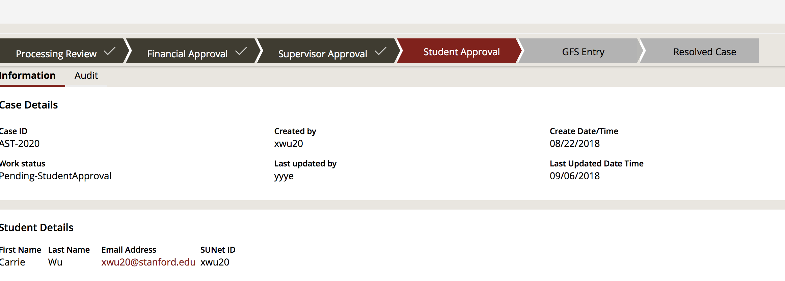
https://stanford.pegacloud.io/prweb/sso

Slide 9
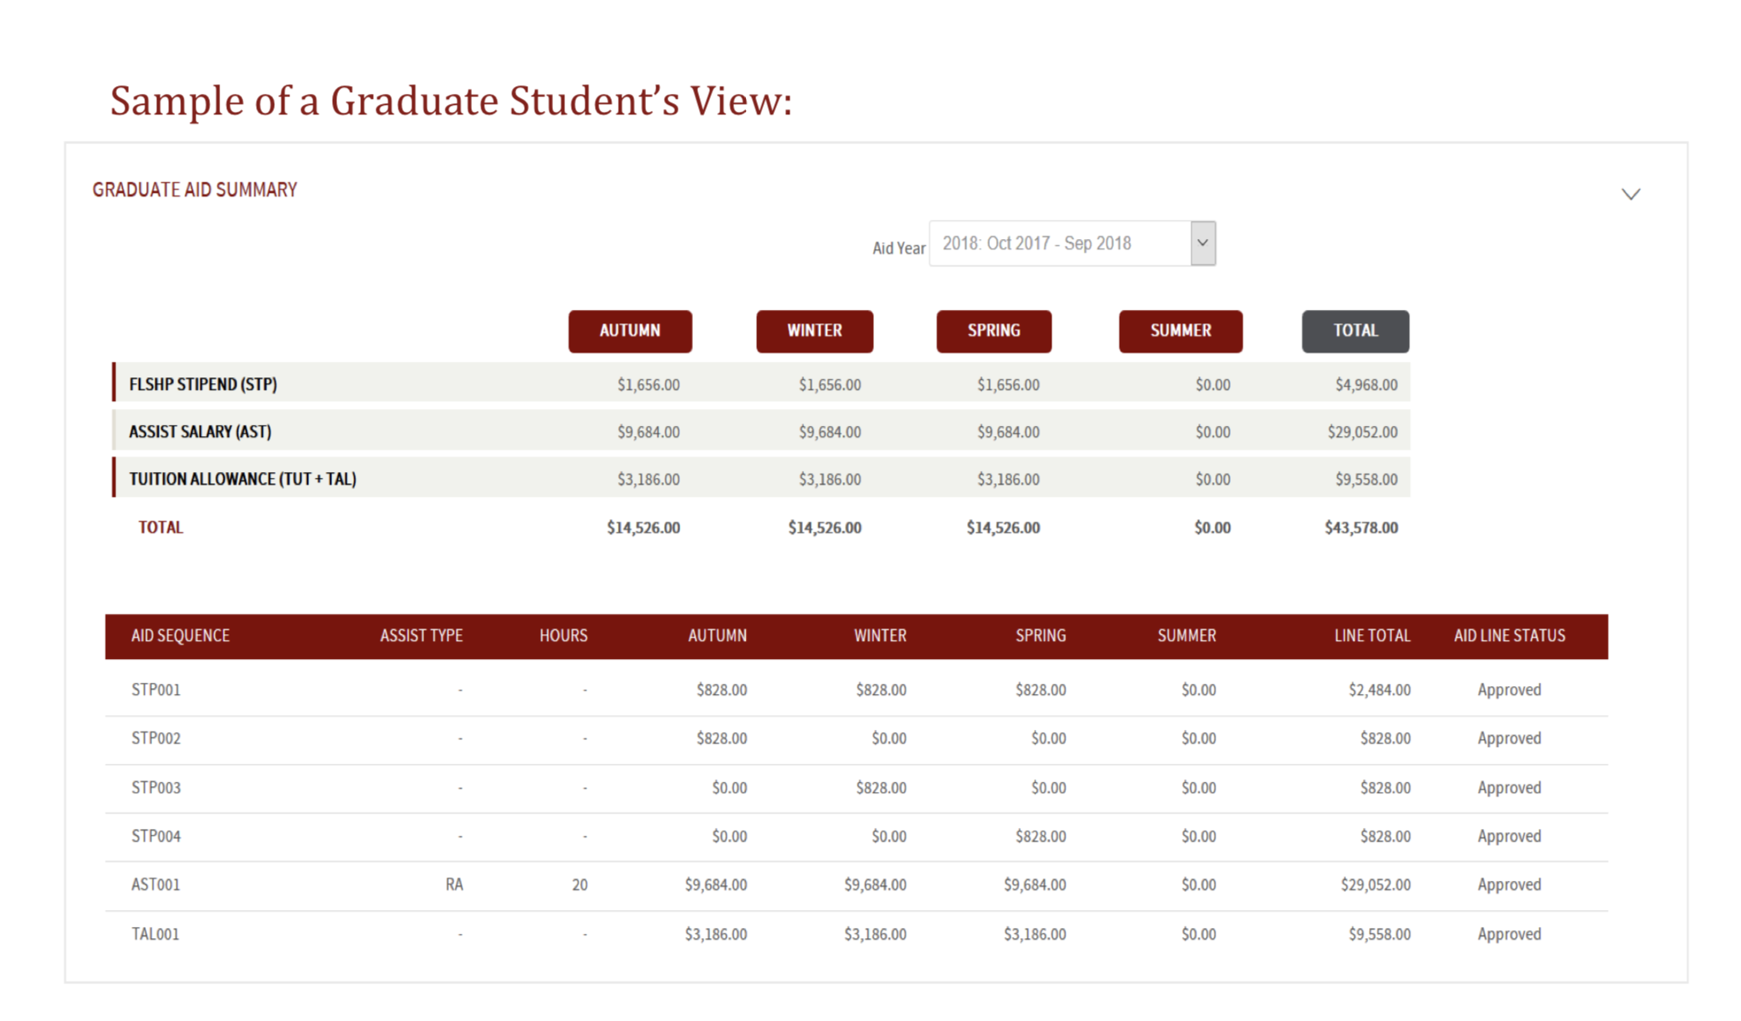

Slide 10
Important Dates
Sept 26 First day of Autumn Quarter; instruction begins
Sept 26, 5pm Preliminary Study List deadline
Oct 14, 5pm Final Study List deadline
(All course enrollment, units, grading basis must be finalized)

Slide 11
Some useful resources on our Gates internal website
https://cs.stanford.edu/internal/student-info
https://cs.stanford.edu/internal/student-info/fellowship-opportunities
https://cs.stanford.edu/internal/student-info/phd-rotation-statistics
https://cs.stanford.edu/sites/default/private/Resources_for_CS_PhD_Students.pdf

